Slide 1



AWS IAM
Akshit Khamesra
Aryamaan Pandey
Sanchita Rawat
Sparsh Agarwal

Slide 2

Amazon Web Services(AWS)
AWS stands for Amazon Web Services,
The leading cloud provider in the marketplace is AWS
Amazon Web Services (AWS) platform provides more than 200 fully featured services from data centers located all over the world.

Slide 3
AWS Security
Cloud security is the highest priority in AWS.
There are many types of security services available but some of them are widely used by AWS, such as:
IAM
Key Management System (KMS)
Cognito
Web Access Firewall (WAF)

Slide 4
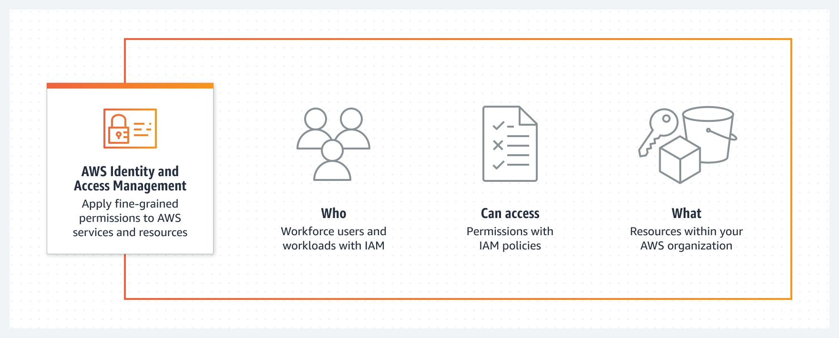
What is IAM?

Slide 5
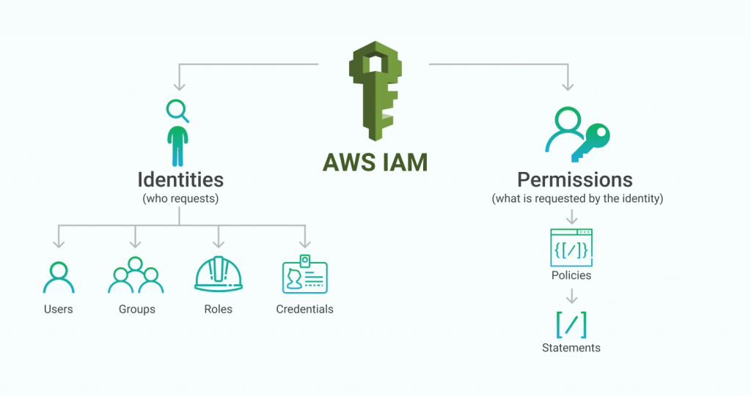
IAM Terms

Slide 6
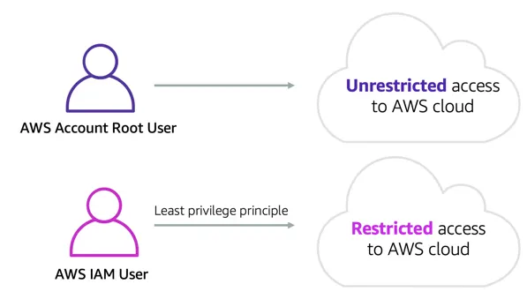
IAM Users
An AWS Identity and Access Management (IAM) user is an entity that you create in AWS.
The IAM user represents the human user or workload who uses the IAM user to interact with AWS.
A user in AWS consists of a name and credentials

Slide 7
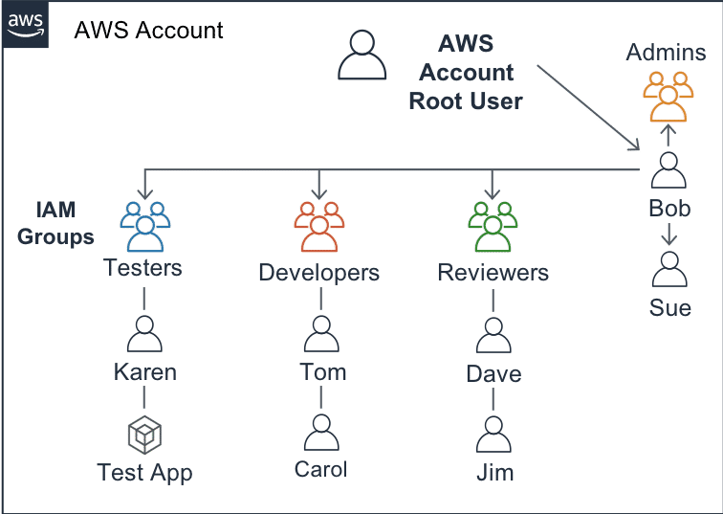
IAM Groups

Slide 8
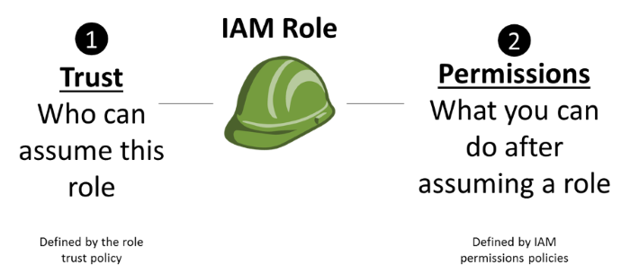
IAM Roles

Slide 9
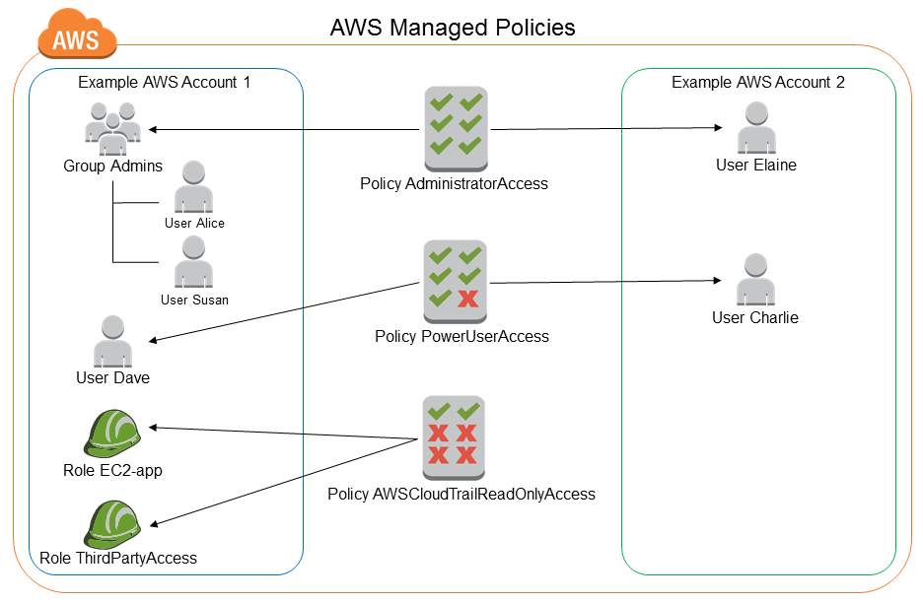
IAM Policies
An AWS IAM policy defines the permissions of an identity (users, groups, and roles)
Permissions defined within a policy either allow or deny access for the user.
IAM policies can either be identity-based or resource-based.

Slide 10
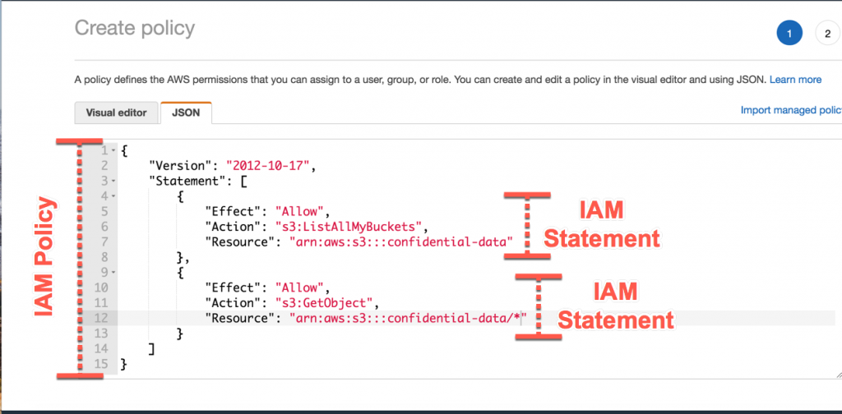
IAM Policy Example

Slide 11
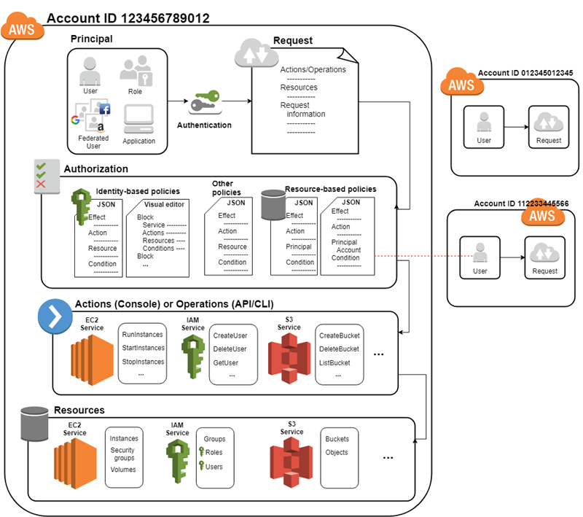
Working of IAM
The IAM infrastructure includes the following elements:
Principal
Request
Authentication
Authorization
Actions or Operations
Resources
Notes:
https://docs.aws.amazon.com/IAM/latest/UserGuide/intro-structure.html

Slide 12
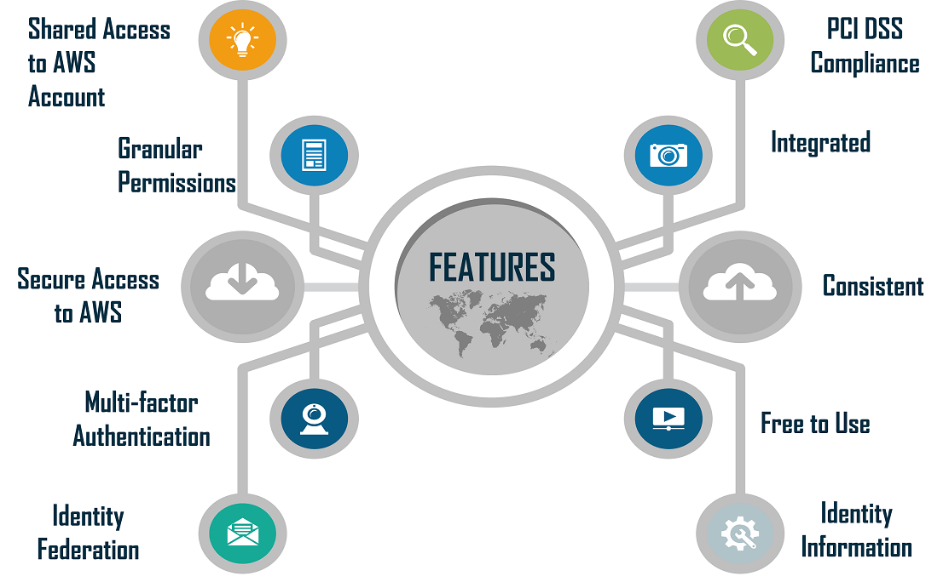
IAM Features
Notes:
https://www.google.com/url?sa=i&url=https%3A%2F%2Fwww.edureka.co%2Fblog%2Fidentity-and-access-management%2F&psig=AOvVaw3iDt2gKOH5oEfslleXEwb3&ust=1674995131478000&source=images&cd=vfe&ved=0CBAQjRxqFwoTCNj37qCh6vwCFQAAAAAdAAAAABAn

Slide 13
Why IAM?
Enhances Data Security
Streamlines IT Workload
Helps in Regulatory Compliance
Reduces Human Error
More Effective Access to Resources
Confidentiality of Data
Helps Manage Access Across Browsers
Notes:
https://www.techtarget.com/whatis/8-Reasons-Identity-and-Access-Management-Is-Important

Slide 14
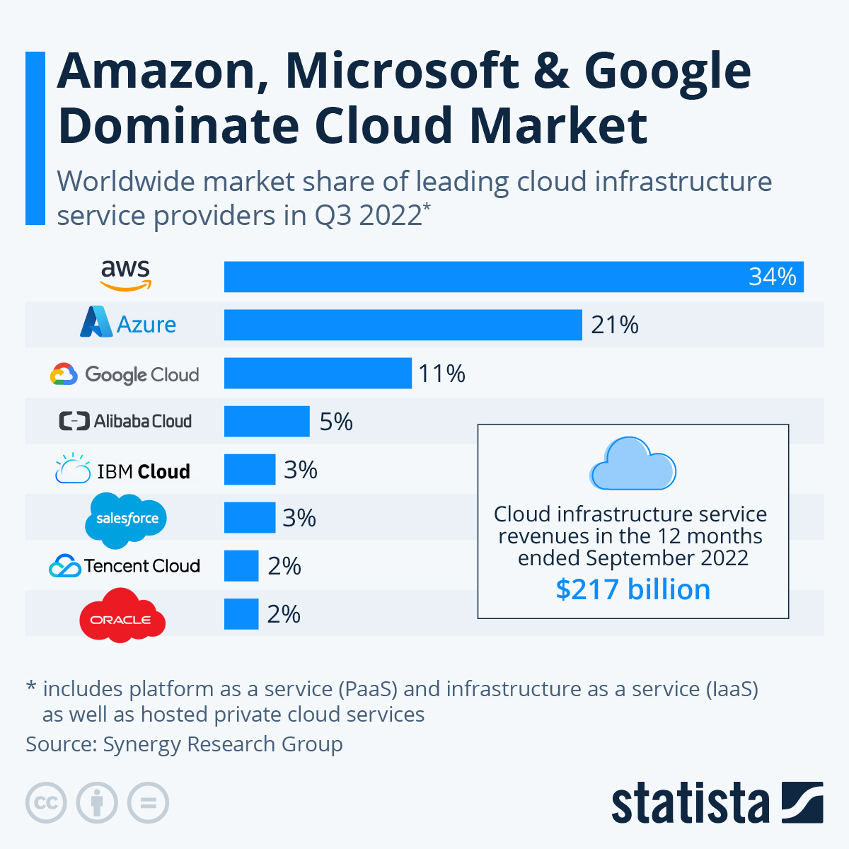
Worldwide market share of leading cloud infrastructure service providers
Reference: https://www.statista.com/chart/18819/worldwide-market-share-of-leading-cloud-infrastructure-service-providers/
Notes:
https://enlyft.com/tech/products/amazon-aws-identity-and-access-management-iam

Slide 15
Demo for IAM with AWS S3

Slide 16
THANK YOU

